Slide 1
Air ticket booking SYSTEM
- Vignesh.R

Slide 2
OVERVIEW
WHY ATBS ?
Target users..
Needs..
HOW ?
The web based “Airline Reservation System” project is an attempt to stimulate the basic concepts of airline reservation system.

Slide 3

Objective

Slide 4

Targeted Users
Passengers
Airlines Admin

Slide 5
Functional needs
User accounts
Reservation of seats
View or query flight status
Cancellation of ticket

Slide 6
Non-functional needs
Performance
Interactive UI
Reliability
Usability

Slide 7

Tech & stuffs

Slide 8
Use case . . .

Slide 9
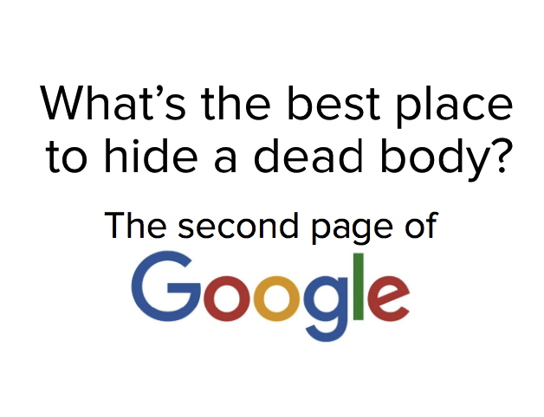

THE END

